Slide 1
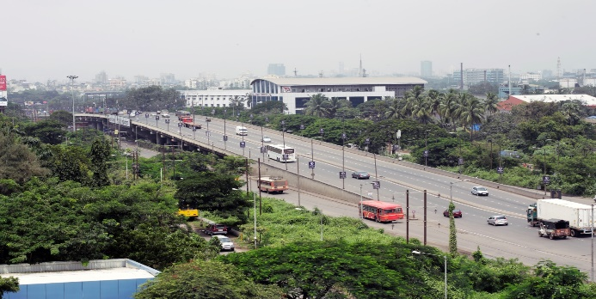
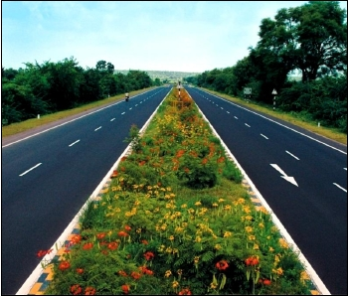
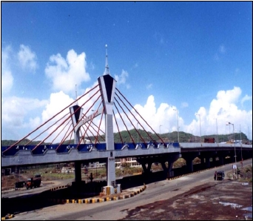
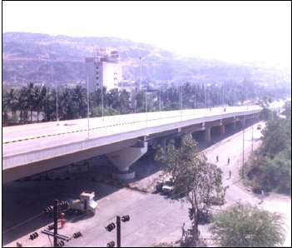
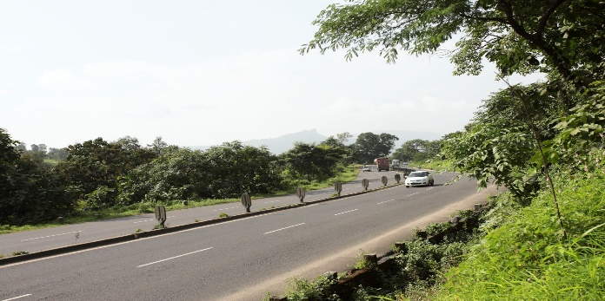
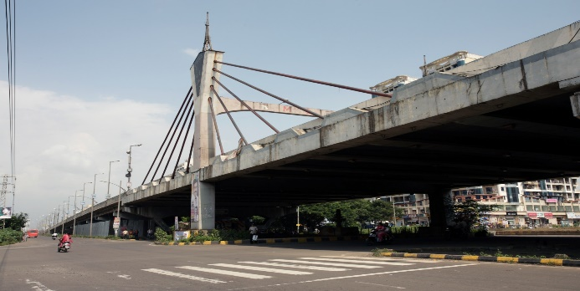
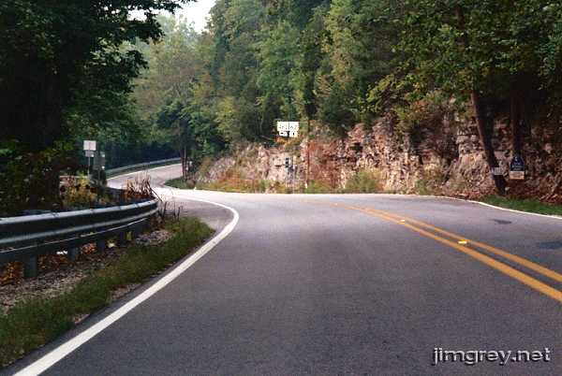
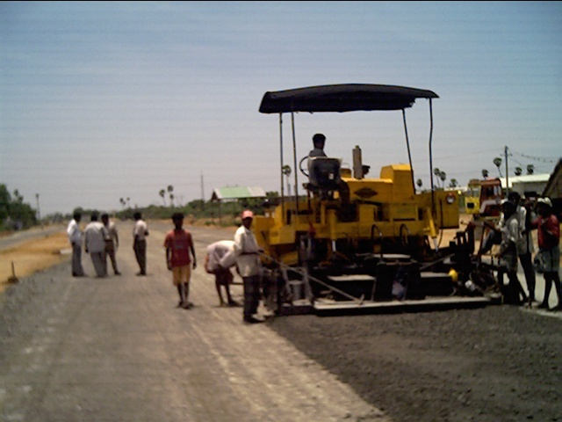
Transwat Techno-Engineering Services Ltd
[ Formerly Wadia Techno-Engineering Ltd ]
(Est. in 1960)
( HIGHWAYS PROFILE )
Design / Project Management Consultants for Highways, Bridges, Elevated Roads - Buildings (Commercial, Industrial, Institutional Buildings etc;)
- Major Irrigation (Reservoirs, Dams, Tunnels, Lift Irrigation, Canals) - Smart Cities - Water Supply - Industrial Parks - Logistic Parks
8-2-686/K/1&2, C-3, 2nd Floor,‘Kimtee Square’
Road No. 12, Banjara Hills, Hyderabad–500034 Tel : +91 40-23320233
Fax : 040-23384148 Email : bd@transwat.com; www.transwat.com

Slide 2
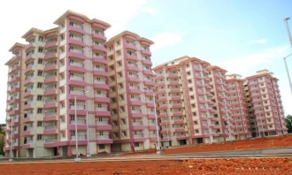
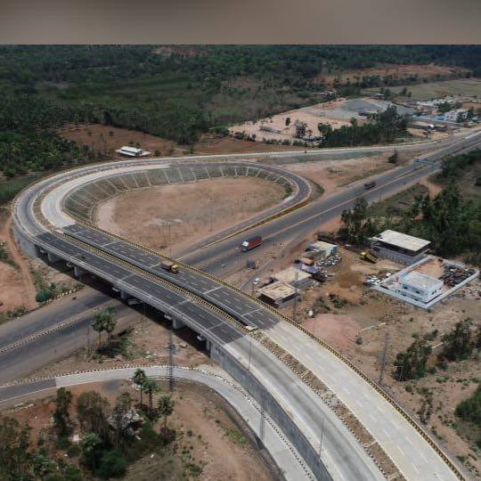
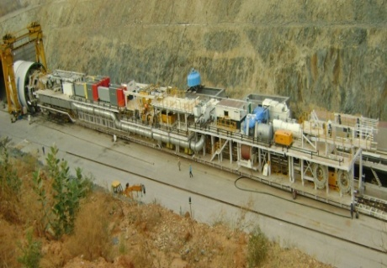

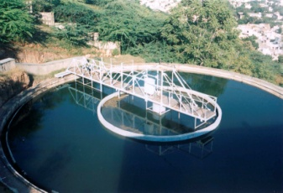
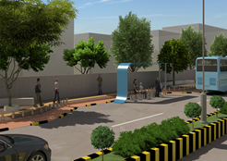
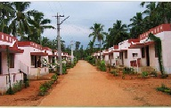
About Transwat Techno-Engineering Services Ltd (Formerly Wadia Techno-Engineering Services Ltd. )
Transwat Techno Engineering Services Limited, (TTESL), est. 1960, having Registered Office in Mumbai, has Completed consultancy for over 5000 projects on Pan India in the last 65 years, in varied sectors, viz., Transportation, Water, Buildings, Industrial, Logistics etc, has expertise & resources to offer consultancy services for various projects such as:
Buildings - Institutional such as Corporate Offices, University Buildings, Buildings for IITs, Medical College Campuses, Law College etc , Commercial Constructions, Multiplex Industrial Constructions, Residential Accommodations, Hospitals, Five Star Hotels, Recreational Infrastructure, Religious projects, and etc.
Transportation - Highways, Expressways, Elevated Roads, Fly over / ROBs, Major Bridges, City Smart Roads, Rigid Pavements, Logistic Parks, Utility Shifting Projects etc;
Major Irrigation Projects viz., Dams, Reservoirs, Canals, Tunnels, Lift Irrigation etc, Water Supply, Sewerage, Storm Water & associated infrastructure etc,
Urban Planning, Engineering, and Development right from the stage of Concept to completion, including extensive Urban Engineering Services for Water and Sanitation, Roads, Utilities, revamping of existing infrastructure & systems, Smart City Projects, Development of Parks, Environmental related Projects, etc;
Industrial Estate Development, SEZ, Industrial Parks, IT Park, Electronics Park, Textile Park, and etc;
Property Development Projects, etc,
Successfully completed consultancy for BOT / PPP Projects as also for various externally funded projects such as World Bank Projects, ADB Projects etc.
2
Formerly Wadia Techno-Engineering Services Ltd
Transwat Techno-Engineering Services Ltd

Slide 3
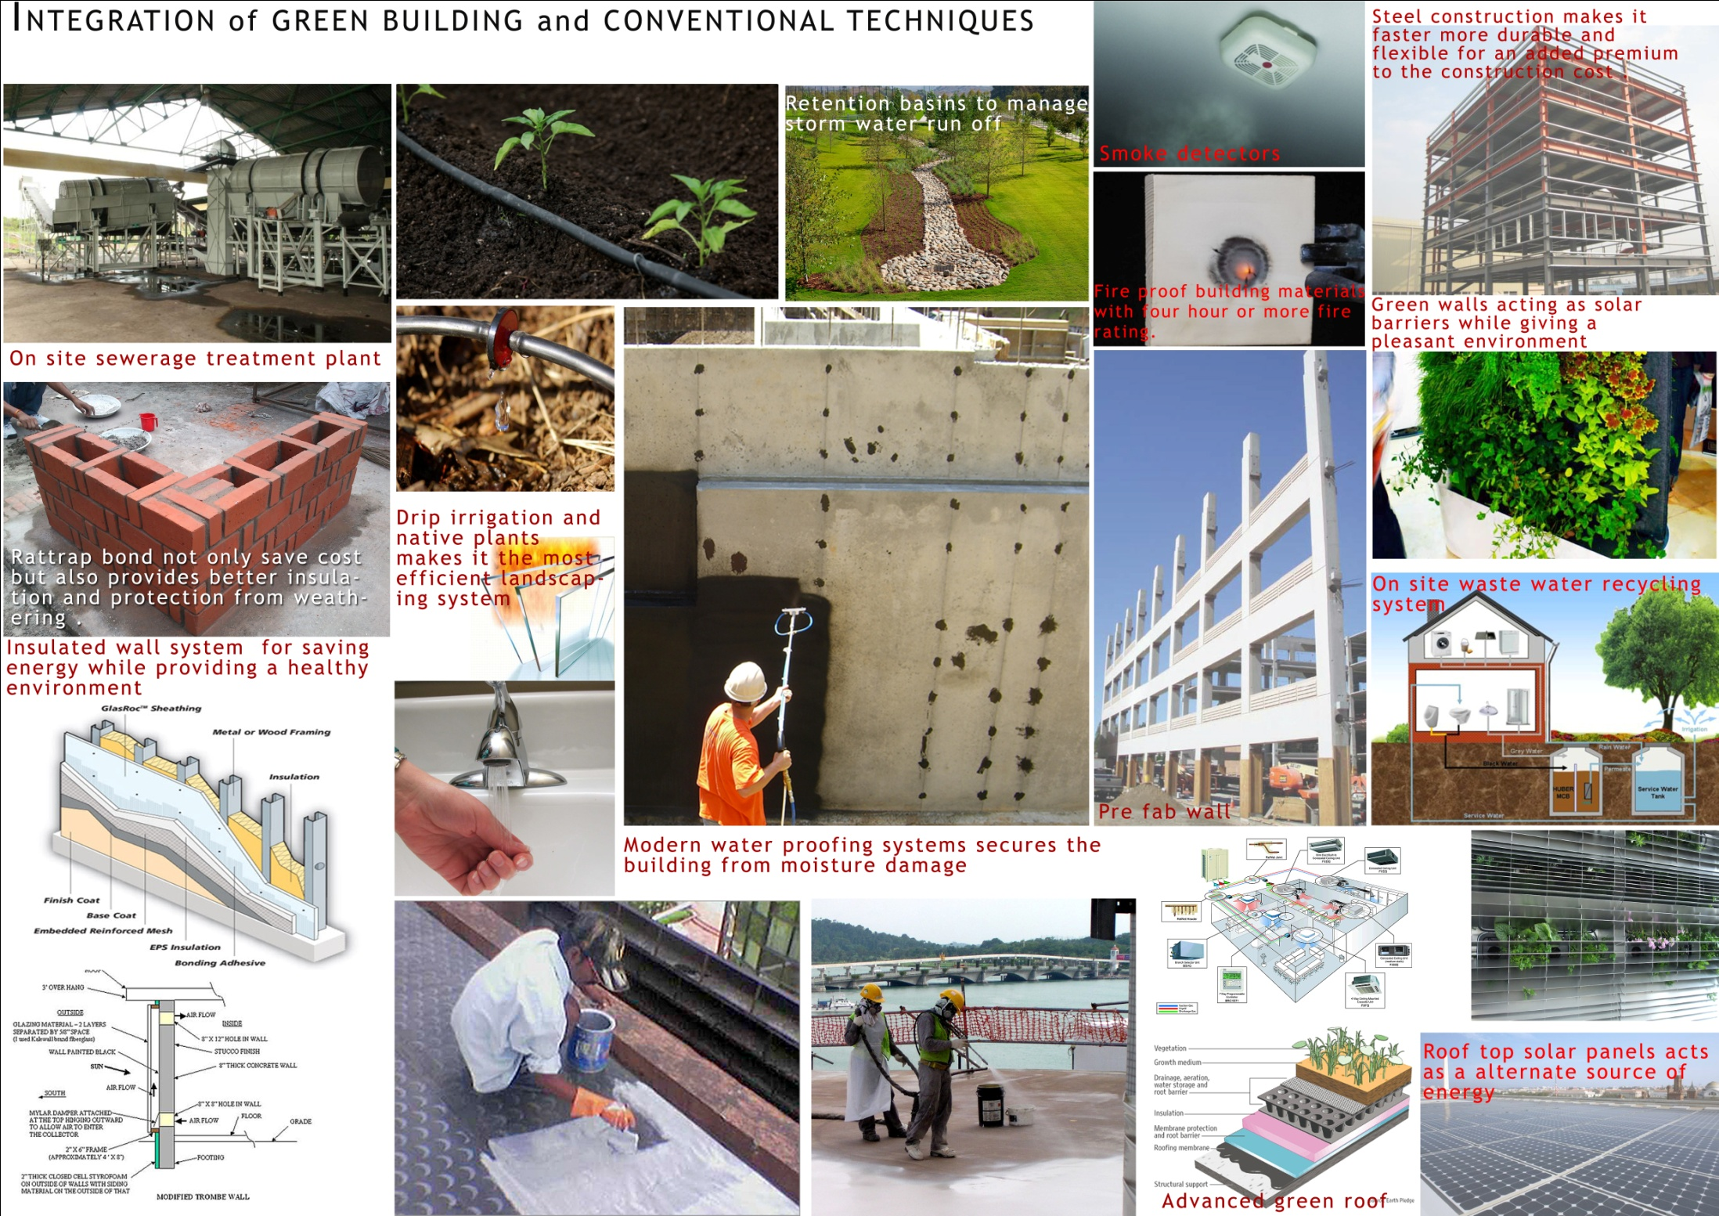
GREEN RECOMMENDATIONS as IGBC Founder Member
3
Wadia Techno-Engineering Services Ltd
Transwat Techno-Engineering Services Ltd

Slide 4
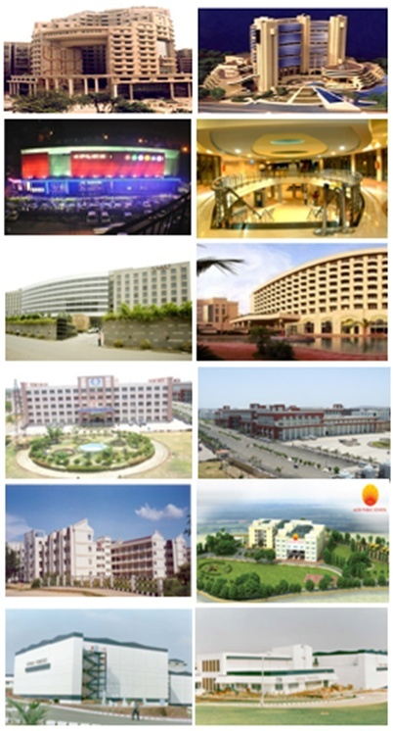
Consultancy Services –Commercial, Residential Buildings and other sectors
Preparation of Master Plan, Detailed Design Engineering, Drawings & Estimates, Tendering process, Bid Evaluation, Project Management Consultancy, Third Party Quality Control / Assurance, Value Engineering, Technical Audit
Financial Institutions and Corporate Sector
Commercial Centers (with Multi-Plex)
Hotels, Tourism & Entertainment sectors
Hospitals and Health Care sector
Educational Institutions Sector
Township Planning and Housing Sector
Transwat Techno-Engineering Services Ltd

Slide 5
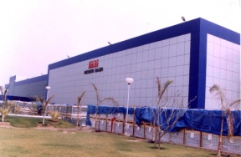
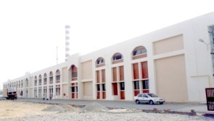
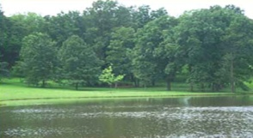

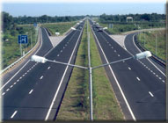
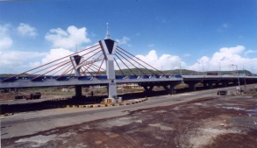
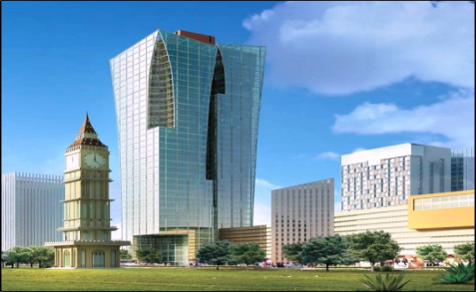
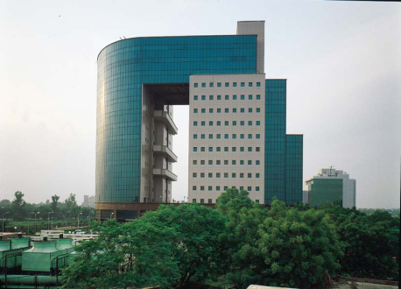
Consultancy Services - Other areas - Infrastructure
Preparation of Master Plan, Detailed Design Engineering, Drawings & Estimates, Tendering process, Bid Evaluation, Project Management Consultancy, Third Party Quality Control / Assurance, Value Engineering, Technical Audit
Industrial Projects
Water and Sanitation
Major and Minor Irrigation
Highways, Bridges, Rural Roads
SEZs, Industrial Parks, IT Parks
Special Projects
Transwat Techno-Engineering Services Ltd

Slide 6
Services provided
MANAGEMENT CONSULTANCY
Market research
FINANCIAL CONSULTANCY
Assistance in bank/private finance
PRE-DESIGN STUDIES
Concept Planning
Business strategy
Sector studies
Location analysis
Technology selection
Techno-economic viability studies/Detailed Project Report (DPR)
Assistance in marketing of products
Strategic alliance and partner search
Corporate debt restructuring
Surveying
Geo-technical investigation
GIS
EIA
DESIGN ENGINEERING CONSULTANCY
Master Planning
Architectural including master planning
Structural design
Utilities design (MEP, HAVC, Fire Fighting, BMS etc.)
Interior Design
Landscape design
PROJECT MANAGEMENT CONSULTANCY
Procurement Assistance
Construction Supervision
Post Commissioning Services
O & M Services and training
Technical Audit
Total Quality Management (TQM)
Safety Audit
Energy Audit and Management
Transwat Techno-Engineering Services Ltd

Slide 7
Key Projects
Transwat Techno-Engineering Services Ltd

Slide 8

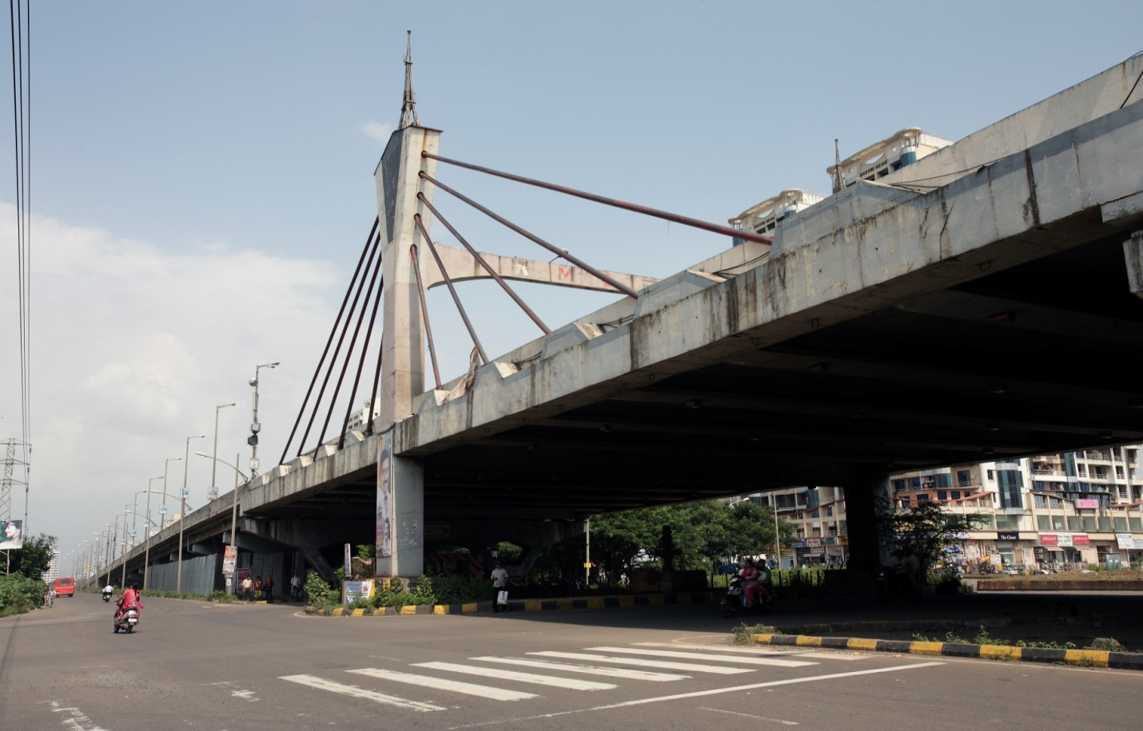

Transportation – Roads / Highways
MSRDC: Kharghar Junction Flyover
Nerul Junction Flyover
Nagpur-Aurangabad-Ghoti-Mumbai
NHAI: Chennai – Ranipet
Aurangabad - Kahudag
Reengus to Sikar – Rajasthan
Ludhiana Talanwadi Section
Rohtak-Jind section
Ambikapur-Pathalgaon section
DPR for Naginimora Town
DPR for Noklak Town
Testing & QA - PWD B&R PUNJAB
DPR for Bhandari Town
Transwat Techno-Engineering Services Ltd

Slide 9
MINISTRY OF ROAD TRANSPORT & HIGHWAYS (MoRTH)
Ministry’s Empanelled Consultant
CATEGORY – I (A) Feasibility Study and Detailed Project presentation for highway projects upto 50 km length consisting of RCC/PSC superstructure bridges upto 60m length
CATEGORY – I (B) Feasibility Study and Detailed Project presentation for all types of highway projects consisting of all types of bridges/grade separators except bridges with innovative design such as cable stayed, suspension bridge, etc
CATEGORY – VI (A) Construction supervision of highway projects upto 50 km length consisting of RCC/PSC superstructure bridges upto 60m length
CATEGORY – VI (B) Construction supervision of all types of highway projects consisting of all types of bridges/grade separators except bridges with innovative design such as cable stayed, suspension bridge, etc
CATEGORY – VII Construction supervision of all types of bridges/grade separators projects but excluding bridges with innovative design such as cable stayed, suspension bridge, etc
CATEGORY – VIIIA Independent Engineer Consultant for PPP highway projects 100 km length & bridges upto 60m length and having RCC/PSC superstructure.
CATEGORY – IX Feasibility Study and Detail Project preparation for highway tunnel Projects.
Transwat Techno-Engineering Services Ltd

Slide 10
Road Experience
Sl. No. | Type of Service | Client | Name of project |  | Length of Road (Kms) | No. of lanes | Sole / JV | Road length
DETAILED PROJECT REPORT/FEASIBILITY STUDY AND DESIGN REPORT
1 | FS & DPR | National Highways Authority of India | Consultancy services for preparation of Feasibility-cum- Preliminary Design Report for rehabilitation & upgrading of existing 2-lane road to 4/6 laning of Ludhiana - Talwandi Section of NH-95 - NHAI/DBFO-II |  |  | 4 lane | Sole | 74.00
 |  |  | From Km. 86.00 to 170.00 | 84.00 | 74.00
2 | DPR | Andhra Pradesh Road Development Corporation, CE(R&B), CRN & MD, Hyderabad | Consultancy services for preparation of Detailed Project Report for upgradation of Anakapalli - Anandapuram (SH-38) via Sabbavaram to four lane road under BOT scheme. |  |  | 4 lane | Sole | 48.00
 |  |  | Anakapalli - Anandapuram | 48.00 | 48.00
3 | FS & DPR | Andhra Pradesh Road Development Corporation, CE(R&B), CRN & MD, Hyderabad | Consultancy services for conducting Detailed Feasibility Study and preparation of DFR for upgradation of Kadapa - Tadipatri road to four lane road under BOT scheme. |  |  | 4 lane | Sole | 84.60
 |  |  | Kadapa - Tadipatri | 84.60 | 84.60
4 | DPR | Andhra Pradesh Road Development Corporation, CE(R&B), CRN & MD, Hyderabad | Consultancy services for preparation of DFR for upgradation of Gondagalonu-Deverapalli-Kovur road to four lane road under BOT scheme. |  |  | 4 lane | Sole | 68.00
 |  |  | Gondagalonu-Deverapalli-Kovur | 68.00 | 68.00
5 | Design & Supervision | Rajasthan Urban Sector Development Investment Program (RUIDP), Govt. of Rajasthan | Design & Supervision Consultants for under Rajasthan Urban Infrastructure Development Project (RUIDP) ADB funded project |  |  | 2 lane | Sole | 23.80
 |  |  | Length of Road
 |  |  | Bharatpur Town | 8.80 |  | 4 lane | Sole | 8.80
 |  |  | Dholapur Town | 15.00 |  | 2 lane |  | 15.00
 |  |  | Total Road Length |  | 23.80
 |  |  | Length of Bridge
 |  |  | ROB @ Itarana, Alwar | 0.85 |  | 2 lane | Sole | 0.85
 |  |  | ROB @ Jai Marg, Bharatpur | 0.74 |  | 2 lane |  | 0.74
 |  |  | ROB @ Kherda, Sawai Madhopur | 0.94 |  | 2 lane |  | 0.94
 |  |  | Total Bridge Length |  | 2.53
6 | DPR | National Highways Authority of India | Consultancy services for preparation of Detailed Project Report for Birmitrapur - Pallahara Section of NH-23 in the state of Odhisa. |  |  | 4 lane | Sole | 102.40
 |  |  | Birmitrpur-Plhara | 128.00 | 102.40
Transwat Techno-Engineering Services Ltd

Slide 11
Road Experience
CONSTRUCTION SUPERIVISION / PMC / INDEPENDENT ENGINEER
1 | CS | Executive Engieer, NH Division, Kadapa [Ministry of Road Transport & Highways (MoRTH)] | Authority Engineer for Rehabilitation and upgradation of existing NH-565 from Km 425/400 to Km 509/400 (Penchalakona to Yerpedu section) to two lane with paved shoulder in the State of AP through EPC.
 |  |  | 2 Lane | 79.63 |  | 2 Lane | 79.63
 |  |  | 4 Lane | 3.95 |  | 4 Lane | 3.95
 |  |  | Total | 83.58 |  |  | 83.58
2 | CS | Public Works Department Central Works, (B&R) PWD, B LDN, Ferozpur | Independent quality control consultant for Ferozepur Fazilka road project on B.O.T. Basis
 |  |  | Ferozepur - Fazilka - 2 Lane | 81.30 |  | 2 Lane | 81.30
 |  |  | Ferozepur - Fazilka - 4 Lane | 5.00 |  | 4 Lane | 5.00
 |  |  | Total | 86.30 |  |  | 86.30
3 | CS | Executive Engineer, Construction Division No. 1, PWD., B&R Br.Ludhania | Independent quality control Consultant for construction, upgradation, operation and maintenance of Dakha-Raikot Barnala road corridor on B.O.T. Basis. |  |  | 2 Lane | 57.94
 |  |  | Dhaka-Rajkot | 57.94 | 57.94
4 | CS | Maharashtra State Road Development Corporation Ltd., Nagpur | Project Management Consultancy services for Strengthening of Tarala & Shelu Bazar town portion roads and improvement of Mehekar - Dusarbid - Sindkhedraja - Buldhana District Road - Jalna Road |  |  | 2 Lane | 70.33
 |  |  | Package - VII | 5.33 | 70.33
 |  |  | Package - IX | 65.00
5 | CS | Govt. of Mizoram Project Director - PIU, PWD, Aizawl | Supervision Consultancy Services for Improvement and Upgradation of Mizoram State Roads Project (Phase-II) under World Bank Fund |  |  | 2 Lane | 123.00
 |  |  | Improvement and Upgradation of PIB: Buangpui-Lunglei Section | 68.00 | 123.00
 |  |  | BPI : Aizawal bypass Road | 13.00
 |  |  | M6 Zobawk - Haulawng Road | 30.00
 |  |  | M16 - Selesih - Thuampui Road | 12.00
6 | Design & Supervision | Rajasthan Urban Sector Development Investment Program (RUIDP), Govt. of Rajasthan | Design & Supervision Consultants for under Rajasthan Urban Infrastructure Development Project (RUIDP) ADB funded project
 |  |  | Length of Road
 |  |  | Bharatpur Town | 8.80 |  | 4 lane | 8.80
 |  |  | Dholapur Town | 15.00 |  | 2 lane | 15.00
 |  |  | Total Road Length |  | 23.80
 |  |  | Length of Bridge
 |  |  | ROB @ Itarana, Alwar | 0.85 |  | 2 lane | 0.85
 |  |  | ROB @ Jai Marg, Bharatpur | 0.74 |  | 2 lane | 0.74
 |  |  | ROB @ Kherda, Sawai Madhopur | 0.94 |  | 2 lane | 0.94
 |  |  | Total Bridge Length |  | 2.53
7 | CS | National Highways Authority of India, Chennai | Consultancy services for upgrading of the Poonamallee to Walajapet section of the NH-4 Construction Supervision Contract RC 1 & 2 (Km 13/8 to Km 106/5) |  |  | 4 lane | 92.25
 |  |  | Poonamallee to Walajapet | 92.25 | 92.25
Transwat Techno-Engineering Services Ltd

Slide 12
Road Experience
Category: DPR
Sr. No. | Name of the Projects | Start Date | End Date | Road/Bridge Length | Project Cost
1 | Consultancy Services for preparation of Feasibility-cum Preliminary Design Report for rehabilitation and upgrading of Existing 2-lane road to 4/6-laning of Rohtak-Jind section of Nh-71 to be executed as BOT Project on DBFO pattern under NHDP Phase III in the State of Haryana (Package No. NHAI/BOT/DBFO/HRY/01 and Length 45 km). | June 2009 | Ongoing | 45 kms | Rs. 84.91 Lakhs
2 | Consultancy services for Preparation of Detailed Project Report for rehabilitation and upgrading to 2 lane with paved shoulders configuration of Ambikapur - Pathalgaon section on NH-78 in the State of Chhattishgarh work order for Design Work. | March 2009 | Ongoing | 95.5 Kms | Rs. 185.87 Lakhs
3 | Consultancy Services for preparation of Detailed Project Report for Rehabilitation and Upgrading to 2 lane with paved shoulders and strengthening of Nagrota-Mubarakpur Section (Km 0 to Km 91) of NH-20A in the state of Himanchal Pradesh (Package No.: SP/D/5) | June 2010 | Ongoing | 91 Kms | Rs. 189.14 Lakhs
4 | Consultancy services for Preparation of Detailed Project Report for Rehabilitation and Upgrading to 2 lanes/2 lane with paved shoulders configuration and strengthening of Rengali-Talchar Section (Km 227 to Km 295) of NH – 200 in the state of Orissa | June 2010 | March 2011 | 68 kms. | Rs. 150.00 Lakhs
Transwat Techno-Engineering Services Ltd

Slide 13
vg
Category: DPR
Sr. No. | Name of the Projects | Start Date | End Date | Road/Bridge Length | Project Cost Rs. In Lakhs
5 | Preparation of DPR for Upgradation of existing roads and construction of New roads in the state of Nagaland | August 2002 | June 2005 | 354.421 Kms | Rs. 100.00 Lakhs
6 | IRCON, DELHI (77.40 Km Vaishali, Muzzafarpur & Samastipur | February 2006 | November 2008 | 63.482 Kms | Rs. 97.55 Crores
7 | IRCON, DELHI (90.25 Km Samastipur & Darbhanga) | February 2006 | November 2008 | 97.17 Kms | Rs. 186.18 Crores
8 | Preparation of feasibility cum preliminary design report for 4-laning of Reengus to Sikar section of NH-11 to be executed as BOT (Annuity) project (Total Length 44Km) | July 2007 | March 2008 | 44.00 Kms | Rs. 52.00 Lakhs
9 | Consultancy Services for preparation of Feasibility-cum Preliminary Design Report for rehabilitation and upgrading of Existing 2-lane road to 4/6-laning of Ludhiana-Talwandi section of NH-95 to be executed as BOT Project on DBFO pattern under NHDP Phase III in the State of Punjab (Package No. NHAI/DBFO-II/DPR/06 and Length 84 km). | June 2008 | July 2016 | 84.00 Kms | Rs. 109.52 Lakhs
10 | Detailed Project Report for Noklak Town | November 2008 | February 2010 | 60.337 Kms | Rs.5 Crores
Transwat Techno-Engineering Services Ltd

Slide 14
Road Experience
Category: DPR
Sr. No. | Name of the Projects
11 | M.P. Rural Road Development Authority - DPR Consultancy Services for PIU Chhatarpur
12 | DPR for Ramanujganj-Wadrafnagar-Kotdol-Janakpur - 55 KM at Raipur
13 | DPR for Gaiyaband-Bardula Road - 65 KMS at Raipur
14 | DPR for Kumhari-Berla-Bernetara-Nawagarh-MungeliI - 111 KM at Raipur
15 | Haldia Development - DPR of Roads in Purba Medinipur - Group B - West Bengal
16 | CPWD - DPR for State Highways - Bihar under Rastriya Sam Vikas Pkg 5
17 | CPWD - DPR for State Highways - Bihar under Rastriya Sam Vikas Pkg 8
18 | APRDC (KT) - Feasibility study and preparation of DFR for State Highway under BOT scheme.
19 | APRDC (KOVVUR) - Feasibility study and preparation of DFR for State Highway under BOT scheme.
20 | National Highway Authority of India - Consultancy services for preparation of Feasibility-cum-Preliminary Design for 4/6- Laninf of Kalamboli- Mumbra (6 laning) of NH 4 (NHAI/DBFOII/DPR/13), to be executed as BOT (Toll) Project on DBFO Pattern under NHDP Phase III- 22/04/08
21 | Consultancy Services for preparation of DPR for Rehabilitation & Upgrading of NH stretches under NHDP-IVB
Transwat Techno-Engineering Services Ltd

Slide 15
Road Experience
Category: PMC/Supervision
Sr. No. | Name of the Projects | Start Date | End Date | Road Length | Project Cost
1 | Total Project Management Consultancy Services including proof checking, detail topographic survey, Geo-Technical Investigations, Quality Assurance Plan & Control procedures, monitoring of the project for quality, cost & time, liaison with MSRDC & other Government agencies. (6 Lane flyover ) | July 1998 | November 2003 | Length - 728 mtrs. & width - 24.20 mtrs. | Rs. 16.00 Crores
2 | Design, proof checking and PMC for implementation of civil ocnstruction work of 6 lane flyover at Kharghar Junction in Mumbai for MSRDC | July 1998 | January 2000 | Length - 634 mtrs. & width - 24.20 mtrs. | Rs. 14.00 Crores
3 | Construction Supervision for 4-Laning and Strengthening of the existing 2-lane stretches from Chennai to Ranipet (Km 13.8 to Km 106.5) on NH-4 in the State of Tamil Nadu | May 2001 | March 2009 | 92.7 Kms | Rs. 365.00 Crores
4 | Construction Supervision for 4-laning & strengthening of existing 2-lane stretches of NH 3 on N-S & E-W corridor from km 70.0 to km 103.0 in Madhya Pradesh (Package-V) | August 2001 | June 2004 | 33 Kms. | Rs. 101.37 Crores
5 | Supervision & Quality Control for Package Chindwara 01 for Rural Roads under Pradhan Mantri Gram Sadak Yojana | September 2001 | July 2003 | 97.45 Kms | Rs. 1106.59 Lakhs.
6 | Supervision & Quality Control for Package Sagar 01 for Rural Roads under Pradhan Mantri Gram Sadak Yojana | September 2001 | July 2003 | 101.23 Kms | Rs. 1206.97 Lakhs
7 | Supervision & Quality Control for Package Sidhi 01 for Rural Roads under Pradhan Mantri Gram Sadak Yojana | September 2001 | July 2003 | 147.91 Kms | Rs. 1303.95 Lakhs
8 | Project Management Consultancy services for proposed improvement to Nagpur - Mumbai road to NH standards (Pack B) | December 2001 | October 2003 | 76.52 Kms | Rs. 305.00 Lakhs
9 | Supervision & Quality Control for Package Jhabua 2001 – 02 for Rural Roads Under Pradhan Mantri Gram Sadak Yojana | April 2002 | December 2003 | 103.30 Kms | Rs. 1497.06 Lakhs.
10 | Supervision & Quality Control for Package Sagar 2001 – 02 for Rural Roads under Pradhan Mantri Gram Sadak Yojana | March 2002 | December 2003 | 143.90 Kms | Rs. 2012.06 Lakhs.
11 | Consultancy Services for construction supervision and quality control of PMGSY Roads in Jhabua Distt. | February 2008 |  | 108.70 Kms | Rs. 1518.87 Lakhs
Transwat Techno-Engineering Services Ltd

Slide 16
Road Experience
Category: PMC/Supervision
Sr. No. | Name of the Projects | Start Date | End Date | Road Length | Project Cost
12 | Consultancy Services for Quality Control / Quality Assurance in Works of Road & Bridges Under Pradhan Mantari Gram Sadak Yojana | February 2003 | February 2005 | 500 Kms | Rs. 221.00 Lakhs
13 | Supervision & Quality Control for Package Dhar 2001 – 02 for Rural Roads under Pradhan Mantri Gram Sadak Yojana | August 2003 | August 2004 | 105 Kms | Rs. 54.16 Lakhs
14 | Four Laning & Strengthening of Pune-Solapur Road NH 9 from km 14/000 to 40/000 on BOT Basis | March 2003 | December 2004 | 26 Kms | Rs. 72.00 Crore
15 | Construction Supervision Consultancy Services for Improvement and Upgradation of Aizwal Bypass including Bridges and Rehabilitation and Maintenance of Zobawk-Haulawng Road and Selesih-Thuampi Road (WORLD BANK FUNDED) | October 2003 | Ongoing | 184 Kms | Rs. 602.00 Lakhs
16 | Project Management & Consultancy Services for Development of Roads and other amenities at ward B & C Gawathan Area at PCMC | May 2004 | May 2006 | 14 Kms | Rs. 117.50 Lakhs
Transwat Techno-Engineering Services Ltd

Slide 17
Road Experience
Category: PMC/Supervision
Sr. No. | Name of the Projects
17 | PWD - Hoshiarpur - Tanda Road on BOT Basis IQC
18 | Consultancy for upgradation of Road & Bridges (2 Nos.) in Bihar
19 | Rajasthan Urban Develoment Investment Program(RUSDIP: RUIDP Phase II) - Design & Construction Supervision Consultancy (DSC) Services Package I (Bharatpur)
20 | Consultancy services for Construction Supervision, Project Management and Quality Control for the work of "Upgradation of 6 Central Business District Roads in Bangalore city as per "Tender SURE" Standards
Transwat Techno-Engineering Services Ltd

Slide 18
Road Experience - Ongoing
Experience as Independent Consultant / Construction Supervision of Highway projects during the last 7 years
Sl. No | Type of Services rendered | Description of Highway Project / Length (kms ) |  | Client (with complete address contact person, telephone Nos. and Fax Nos.) | Total Fee for the Consultancy Assignment (INR) | %age of total fee received by the firm | Approx. cost of Highway Project (Rs. in crores)
( 1 ) | ( 3 ) | ( 4 ) |  | ( 5 ) | ( 6 ) | ( 8 ) | ( 9 )
Completed / Substantially completed projects
1 | Authority Engineer for the work of Rehabilitation and upgradation of existing NH-565 from Km 425/400 to Km 509/400 (Penchalakona to Yerpedu section) to two lane with paved shoulder in the State of Andhra Pradesh under NHDP–IV through Engineering, Procurement & Construction (EPC) Basis | 84.00 | 84.00 | Ministry of Road Transport & Highways (MoRT&H) / Executive Engineer National Highways Division, Kadapa | 43,977,704 | 90% | 200.69
2 | Independent quality control consultant for Ferozepur Fazilka road project on B.O.T. Basis | 86.30 | 86.30 | Public works department (B&R) SCO 341-342, Sector-34 A, Chandigarh | 8,226,000 | 100% | 135.00
3 | Independent quality control Consultant for construction, upgradation, operation and maintenance of Dakha-Raikot Barnala road corridor on B.O.T. Basis. | 57.94 | 57.94 | Executive Engineer, Construction Division No. 1, PWD., B&R Br.Ludhania | 6,275,000 | 100% | 80.00
4 | Project Management Consultancy services for Strengthening of Tarala & Shelu Bazar town portion roads and improvement of Mehekar - Dusarbid - Sindkhedraja - Buldhana District Road - Jalna Road |  | 70.33 | Maharashtra State Road Development Corporation Ltd., Near Patwardhan High School, Sitabuldi, Nagpur-440012. Tel : 0712-2551088 Fax : 0712-2521936 | 291,500,000 | 100% | 250.00
 | Package - VII | 5.33
 | Package - IX | 65.00
5 | Supervision Consultancy services for improvement and Upgradation of Mizoram State Roads Project (Phase-II) under World Bank Fund |  | 123.00 | Chief Engineer, (Highways) PWD, Mizoram, Govt. of Mizoram, | 245,293,463 |  | 229.46
 | PIB: Buangpui-Lunglei Section | 68.00
 | BPI : Aizawal bypass Road | 13.00
 | M6 Zobawk - Haulawng Road | 30.00
 | M16 - Selesih - Thuampui Road | 12.00
6 | Design & Supervision Consultants for under Rajasthan Urban Infrastructure Development Project (RUIDP) ADB funded project |  |  | Rajasthan Urban Sector Development Investment Program (RUIDP), Government of Rajasthan, | 36,000,000 | 100% | 180.00
 | Length of Road |  | 23.80
 | Bharatpur Town | 8.80
 | Dholapur Town | 15.00
 | Length of Bridge |  | 2.53
 | ROB @ Itarana, Alwar | 0.85
 | ROB @ Jai Marg, Bharatpur | 0.74
 | ROB @ Kherda, Sawai Madhopur | 0.94
7 | Supervision Consultant for Rehabilitation and upgrading of the Poonamallee to Walajapet section of the NH-4 (RC 1 & 2) |  | 92.25 | National Highways Authority of India, 8th Floor, Annexe Building, SPIC House, 88 Mount Road, Guindy, Chennai-600 032.; Tel : 044-22354135; Fax : 044-22354134 | 218,760,821 | 60.72% | 300.00
 | Poonamallee to Walaja section | 92.25
Transwat Techno-Engineering Services Ltd

Slide 19
Road Experience - Ongoing
Projects in Progress
1 | Authority Engineer for (A) Consultancy services (Authority Engineer) for the work of Rehabilitation and up-gradation of NH-221 (New NH-30) from Km 71/0 to 121/0 ( AP/Telangana Border to Rudrampur ) in the State of Telangana to two Lane with paved shoulder under NHDP-IV Phase on EPC Basis and (B)Consultancy services (Authority Engineer) for the work of Rehabilitation and up-gradation of NH-221 (New NH-30) from Km 121/0 to Km.165/0 (Rudrampur to Bhadrachalam) in the State of Telangana to two Lane with paved shoulder under NHDP-IV Phase on EPC Basis | 93.80 Kms | Ministry of Road Transport & Highways (MoRT&H) / Engineer-In-Chief (R&B) / Superintending Engineer (R&B), National Highways Circle, Errumanzil, Hyderabad– 500082 | 62,723,920 | 35% | 430.73
2 | Authority Engineer for the works of “Rehabilitation and upgradation of National Highway-221 (i) from Km 0/0 to 32/735 (Ibrahimpatnam to Chandragudem section) and (ii) from Km 32/735 to 71/200 (Chandragudem to AP / Telangana Border section) to two lane with paved shoulders / four lane in the State of Andhra Pradesh under NHDP-IV through Engineering Procurement and Construction (EPC) basis Contract | 71.20 Kms | Ministry of Road Transport & Highways (MoRT&H) / Project Director, Project Implementation Unit, (PIU), Door No: 16-355-B, Opp: Ratnam High School, Machilipatnam, Krishna District, Andhra Pradesh – 521002 | 57,052,950 | 25% | 303.00
3 | Consultancy services for Authority’s Engineer for Supervision of civil construction works for (I) Rehabilitation and up-gradation of Kathipudi – Start of Kakinada Bypass section from Km 0/000 to Km 26/150 of NH-214 (New NH-216) to Four lane with paved shoulder & (II) Construction of Kakinada bypass from Km. 27.500 to Km. 41.000 in the State of Andhra Pradesh on EPC basis | 45.50 Kms | Ministry of Road Transport & Highways (MoRT&H) / Project Director, Project Implementation Unit, (PIU), Door No: 16-355-B, Opp: Ratnam High School, Machilipatnam, Krishna District, Andhra Pradesh – 521002 | 68,434,700 | 15% | 412.16
4 | Consultancy services for Authority’s Engineer for Supervision of civil construction works for Rehabilitation and up-gradation of Gurajanapalli village – Polekuru village section(from km. 41/161 to 59/800) and Komagiri –Pasarlapudi section (km. 70/400 to 105/170) of NH-214 (new NH-216) to two lane with paved shoulder in the State of Andhra Pradesh on EPC basis) | 53.41 Kms | Ministry of Road Transport & Highways (MoRT&H) / Project Director, Project Implementation Unit, (PIU), Door No: 16-355-B, Opp: Ratnam High School, Machilipatnam, Krishna District, Andhra Pradesh – 521002 | 67,104,000 | 10% | 207.68
5 | Consultancy services for Authority’s Engineer for Supervision of civil construction works for Rehabilitation and up-gradation of Losari to Machavaram section from Km 34/230 to Km 84/550 of NH-214A (New NH-216) to two lane with paved shoulder in the state of Andhra Pradesh under NHDP –IV on EPC Mode | 50.32 Kms | Ministry of Road Transport & Highways (MoRT&H) / Project Director, Project Implementation Unit, (PIU), Door No: 16-355-B, Opp: Ratnam High School, Machilipatnam, Krishna District, Andhra Pradesh – 521002 | 61,282,700 | Under Mobilization | 304.36
6 | Consultancy services for Authority’s Engineer for Supervision of Rehabilitation & Upgradation of NH-111 from Km. 163.400 to Km 215.800 (Shivnagar to Ambikapur Section) in the State of Chhattisgarh to two lanes with paved shoulder under NHDP-IV on EPC basis | 52.40 Kms | Ministry of Road Transport and Highways (MoRTH) / Chief Engineer (National Highways), Project Implementation Unit (PIU), Raipur – 492 001, CHHATTISGARH | 61,933,200 | Under Mobilization | 246.28
Transwat Techno-Engineering Services Ltd

Slide 20
Road Experience - Ongoing
Experience in DPR / Feasibility Study cum Preliminary Design Report preparation of 2/4/6 laning / Bridge Highway Projects during the last 7 years.
Sl. No | Type of Services rendered | Length of Project (kms ) | Client (with complete address contact person, telephone Nos. and Fax Nos.) | Total Fee for the Consultancy Assignment (INR) | %age of total fee received by the firm
( 1 ) | ( 3 ) | ( 4 ) | ( 5 ) | ( 6 ) | ( 8 )
Completed / Substantially completed projects
1 | Consultancy services for preparation of Feasibility-cum- Preliminary Design Report for rehabilitation & upgrading of existing 2-lane road to 4/6 laning of Ludhiana - Talwandi Section of NH-95 - NHAI/DBFO-II | 84.00 | National Highway Authority of India Project Implementation Unit (PIU), 135, Guru Amar Dass Nagar, Near Verjka Milk Point, Jalandhar – 144008, PUNJAB The Project Director, TeleFax : 0181-2603642 Email : nhaijal181@yahoo.in | 10,952,000 | 90%
2 | Cosultancy Services for preparation of Detailed project report for Rehabilitation and upgrading of existing 2-lane with paved shoulders of Birmitrpur-Plhara section on NH-23 in the state of Orissa | 128.00 | National Highway Authority of India Project Implementation Unit (PIU), 135, Guru Amar Dass Nagar, Near Verjka Milk Point, Jalandhar – 144008, PUNJAB The Project Director, TeleFax : 0181-2603642 Email : nhaijal181@yahoo.in | 10,553,747 | 80%
4 | Consultancy services for conducting Detailed Feasibility Study and preparation of DFR for upgradation of Kadapa - Tadipatri road to 4 (four) lane road under BOT scheme. | 84.60 | Andhra Pradesh Road Development Corporation, CE(R&B), CRN & MD, Hyderabad | 5,405,000 | 88.64%
5 | Consultancy services for preparation of Detailed Project Report for upgradation of Anakapalli - Anandapuram (SH-38) via Sabbavaram to 4 (four) lane road under BOT scheme. | 48.00 | Andhra Pradesh Road Development Corporation, CE(R&B), CRN & MD, Hyderabad | 5,225,000 | 97.97%
6 | Consultancy for Detailed Feasibility Study and Preparation of DFR for upgradation of Gundagolanu to Kovvur Road to four lane road under BOT Scheme | 68.00 | Andhra Pradesh Road Development Corporation, CE(R&B), CRN & MD, Hyderabad | 2,942,512 | 95.32%
Transwat Techno-Engineering Services Ltd

Slide 21
Road Experience - Ongoing
B. Projects in Progress
1 | Cosultancy Services for preparation of Detailed project report for Rehabilitation and upgrading of existing 2-lane with paved shoulders of Ambikapur - Pathalgaon sectio on NH-78 | 84 Kms | National Highway Authority of India G5 & 6, Sector - 10, Dwaraka, New Delhi - 110075; Telephone : 011-25074100; Fax : 011-25093507 | 16,838,500 | 56.18%
2 | Cosultancy Services for preparation of Detailed project report for Rehabilitation and upgrading of existing 2-lane with paved shoulders of Nagrota- Mubarakpur section on NH-20A | 91 Kms | Ministry of Road Transport & Highways, Govt. of India, Transport Bhavan, 1 Parliament Street, New Delhi - 110001 | 17,148,000 | 15.55%
3 | Cosultancy Services for preparation of Detailed project report for Rehabilitation and upgrading of 2 lanes / 2 Lane with paved shoulders and strengthening of Rengali - Talchar Section (Km 227 to Km 295) of NH 200 in the State of Orissa | 68 Kms | Ministry of Road Transport & Highways, Govt. of India, Transport Bhavan, 1 Parliament Street, New Delhi - 110001 | 15,015,000 | 20.00%
4 | Consultancy Services for Feasibility Study, Detailed project Report, survey and Preparation of Land Plan Schedules for By-pass with Four/Six Lane or an Elevated Corridor with Six lane from Km 7.800 to Km 14.200 of NH-163 to de-congest the Urban stretches of HYDERABAD-BHOOPALAPATNAM stretch in the State of Telangana | 16 Kms | Roads & Buildings Department, Superintending Engineer (R&B), National Highway Circle, ErrumManzil, Hyderabad, Telangana State | 8,286,123 | 10.00%
5 | Consultancy Services for Feasibility Study, Detailed Project Report, Survey and Preparation of Land Plan Schedules for Widening to Two / Four lane with paved shoulders from Km 181.800 to Km 226.500 & HLBs‟ at Km 4/4, 42/4,181/0-2,182/5, 184/2-4 &197/2-4 of NH-63 on Nizamabad-Jagadalpur Road Section in the State of Telangana | 44.7 Kms | Roads & Buildings Department, Superintending Engineer (R&B), National Highway Circle, ErrumManzil, Hyderabad, Telangana State | 9,515,409 | 10.00%
Transwat Techno-Engineering Services Ltd

Slide 22
Improvement to Nagpur- Mumbai Road to NH Standards Maharashtra
Client Name: MSRDC Ltd.
Length of Road:
76.52 KM
Project Cost:
30.50 Cr
Completion Year:
2004
Services Provided:
Review detailed engineering design and cost estimation for all elements of the highway and review working drawings prepared by the Employer Proof checking of Contractors’ designs. Evaluation of construction bid leading finally to the awarding of contracts Construction Supervision.
Key Features:
Proposed route starting from Butibori on NH7 near Nagpur ending at Ghoti near Igatpuri on NH3
Transwat Techno-Engineering Services Ltd

Slide 23
Flyover at Kharghar Junction, Navi Mumbai, Maharashtra
Client Name:
Maharashtra State Road Development Corporation
Length of Flyover:
0.634 Km
24.20 mts – width
6 lanes flyover
Project Cost:
INR 14 Cr
Completion Year:
2000
Services Provided:
Total Project Management Consultancy services including Proof consultancy Detailed topographic survey of existing carriage way with reference to the proposed flyover
Geo-technical investigations for design of flyover foundations
Quality Control procedures and Quality Management System Scheduling and Monitoring of construction activities
Key Features:
Cable stayed structure for obligatory span (First of its kind in Mumbai City)- 2 Nos of 30m each
P.S.C. Pre-tensioned “I” Girders in viaduct spans – total 18 nos of viaduct spans of approx. 16.55m each
Transwat Techno-Engineering Services Ltd

Slide 24
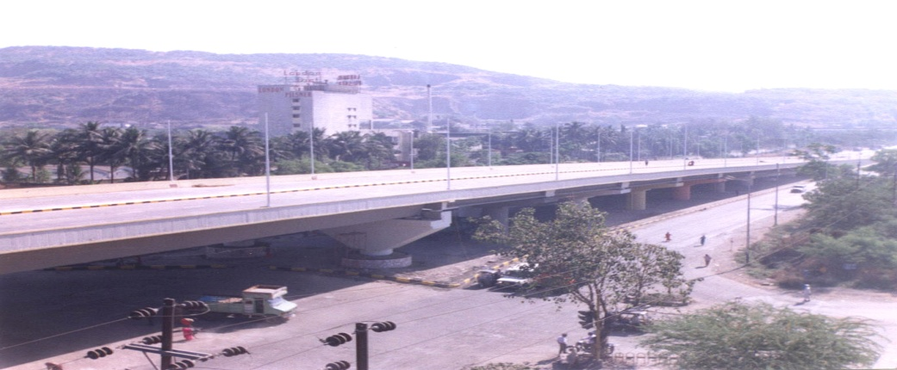
Flyover at Nerul Junction, Navi Mumbai, Maharashtra
Client Name:
Maharashtra State Road Development Corporation
Length of Flyover:
0.880 Km
24.20 m – width
6 lane flyover
Project Cost:
INR 16 CR
Completion Year:
November 1999
Services Provided:
Total Project Management Consultancy services including Proof consultancy Detailed topographic survey of existing carriage way with reference to the proposed flyover
Geo-technical investigations for design of flyover foundations
Quality Control procedures and Check Lists monitoring the implementation of the Quality Management System Scheduling and Monitoring of construction activities
Key Features:
Construction of flyover was completed 25 days ahead of the scheduled date of completion
Transwat Techno-Engineering Services Ltd

Slide 25
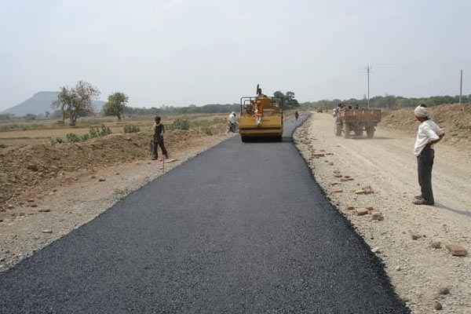
Improvement & Upgradation of Aizwal Bypass, Assam
Client Name:
Govt. of Mizoram, Public Works Department
Length of road:
184Km
Project Cost:
INR 200 Cr
Completion Year:
2004
Services Provided:
Supervision of construction works, which involves embankment, pavement, bridges, CD works, service roads, shoulders, provision of traffic signs etc. Preparation of quality assurance manual and Quality assurance of works
Key Features:
The Improvement Work consists of widening of road with side drains and shoulders, rebuilding the pavements, construction of new bridges and culverts, construction of retaining walls, breast walls, and slope protection works improvement of road geometry and junctions, provisions of road signs .
Transwat Techno-Engineering Services Ltd

Slide 26
Improvement to Nagpur-Aurangabad-Ghoti-Mumbai Road Maharashtra
Client Name:
MSRDC Ltd
Length of road:
700Km
Services Provided:
Project Management Consultancy
Construction Supervision
Key Features:
The proposed road will be 2 lane-tolled highway.
The proposed route, starting from Butibari on NH7 near Nagpur ending at Ghoti near Igatpuri on NH3.
Most of the length upto Sinnar passes through plain & rolling terrain and about 65 Kms from Sinnar to Ghoti passes through hilly terrain.
Transwat Techno-Engineering Services Ltd

Slide 27
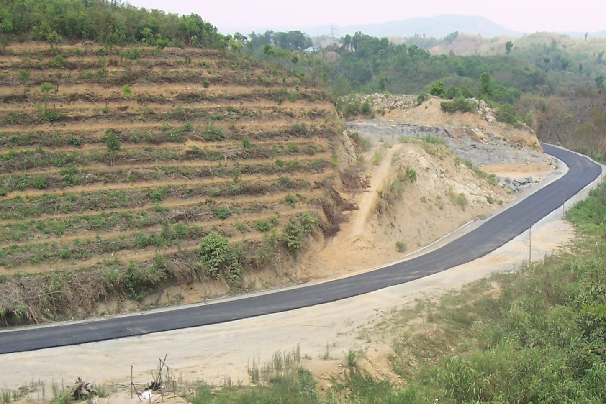
Construction Supervision Consultancy Services for Improvement and Upgradation of Aizwal Bypass including Bridges and Rehabilitation and Maintenance of Zobawk-Haulawng Road and Selesih-Thuampi
Client Name:
Public Works Department, Govt. of Mizoram,
Length of Road:
123.5 Km
Project Cost:
200 Cr
Services Provided:
Design review of road alignment
Design review of Bridge / Structures
Supervision
Key Features:
Strengthening and widening to 2 lane of 123.5 Km. of Road
3 No. of Bridges over Rivers
1 No. of Bypasses
Culverts of various sizes
Transwat Techno-Engineering Services Ltd

Slide 28
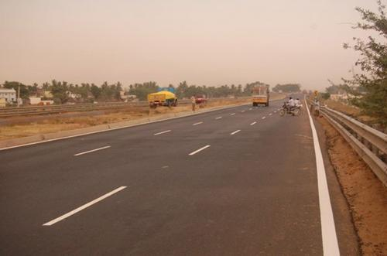
Four Laning and Strengthening of NH-3 Madhya Pradesh
Client Name:
National Highway Authority of India
Services Provided:
Supervision of construction works
Co-ordination between client and the contractor and reporting to the client
Preparation of quality assurance manual and Quality assurance of works
Checking quality of materials, mix design etc and approvals for the same
Key Features:
Widening to 4-lanes and strengthening the existing 2 – lane
Construction of flexible pavement, flexible overlay on existing pavement, construction of bridges and culverts, construction of high embankment/elevated structures etc.
Transwat Techno-Engineering Services Ltd

Slide 29
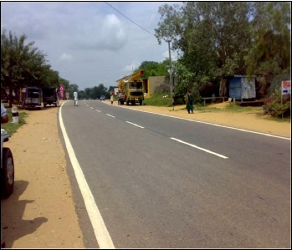
Feasibility of NH-11 – Reengus to Sikar BOT (Toll) Project Rajasthan
Client Name:
National Highways Authority of India
Length of road:
44 Km
Services Provided:
Topographical Survey, Hydrological Survey, Road Inventory, Bridge Inventory Geotechnical Investigations
Traffic Counts, Axle Load Surveys and Estimation of Future Travel Demand Preparation of Feasibility cum Preliminary Design Report Estimation of Project Cost preparation of Technical Schedules and Bid Documents for the project to be executed as BOT (toll) project
Key Features:
Strengthening and widening to 2 lane of 44 Km. of Road
3 No. of Bridges over Rivers
One No. of Grade Separator
1 No. of Bypasses
One No. of Toll Plaza.
Transwat Techno-Engineering Services Ltd

Slide 30
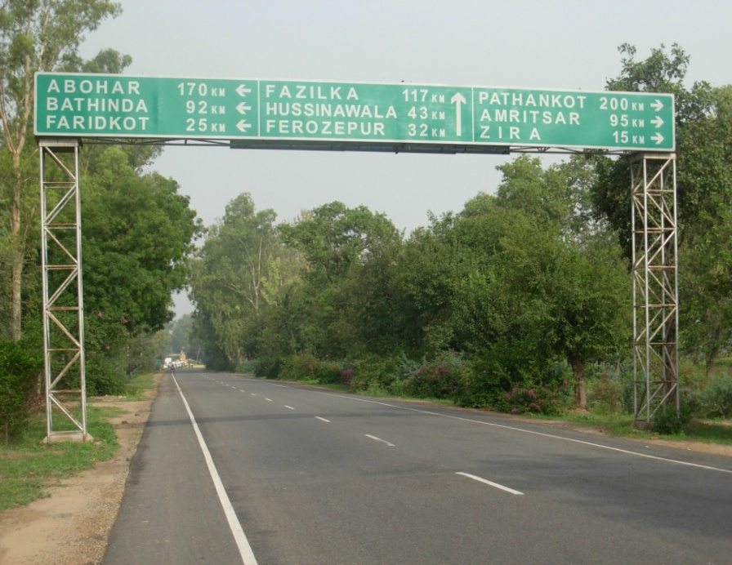
Feasibility of NH-95 - Ludhiana to Talwandi as BOT Project Punjab
Client Name:
National Highways Authority of India
Length of Road:
78 Km
Services Provided:
Topographical Survey, Hydrological Survey, Road Inventory, Bridge Inventory Geotechnical Investigations
Traffic Counts, Axle Load Surveys and Estimation of Future Travel Demand Preparation of Feasibility cum Preliminary Design Report
Highway and Bridge Design
Estimation of Project Cost
Preparation of Technical Schedules and Bid Documents for the project to be executed as BOT (toll) project
Key Features:
Strengthening and widening to 2 lane of 78 Km. of Road
12 No. of Bridges over Rivers, 5 No. of Grade Separator
2 No. of Bypasses, 18 Underpass, 51 RCC Culverts, 28 Bus Bays , 2 Truck Lay Bays, One No. of Toll Plaza
Transwat Techno-Engineering Services Ltd

Slide 31
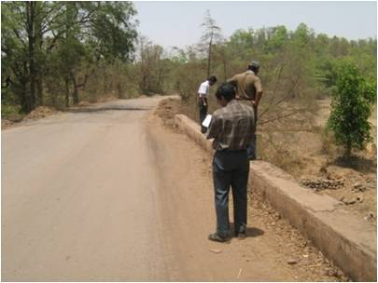
Detailed project report for NH-23 from Birmitrapur to Palhara Orissa
Client Name:
National Highways Authority of India
Length of Road:
128 Km
Services Provided:
Topographical Survey, Hydrological Survey, Road Inventory, Bridge Inventory Geotechnical Investigations
Traffic Counts, Axle Load Surveys and Estimation of Future Travel Demand Preparation of Detailed Project Report Estimation of Project Cost Preparation of Bid Documents
Key Features:
Strengthening and widening to 2 lane of 128 Km. of Road
35 No. of Bridges over Rivers
3 No. of Bypasses
Transwat Techno-Engineering Services Ltd

Slide 32
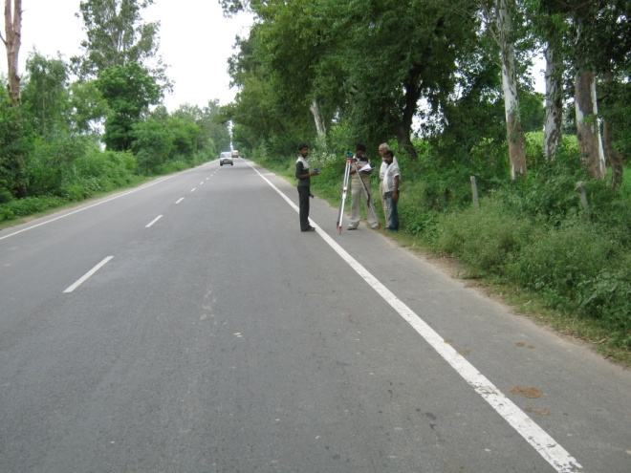
4/6-laning of Rohtak to Jind Section of NH-71 Haryana
Client Name:
National Highways Authority of India
Length of road:
48.60 Km
Services Provided:
Traffic count, axle load surveys and estimation of future travel demand.
topographic, hydrological and surveys Geotechnical Investigation, including testing of the existing road pavement. Conceptual, Preliminary and Design report Preparation of tender documents Estimation of project cost
Key Features:
48.600 km of dual 4 lane carriageway
Service road (18.71km)
1 Grade Separator
8 Minor Bridge, 12 Underpass, 49 RCC Culverts
22 Bus Bays, 2 Truck Lay Bays
1 Toll Plaza
Transwat Techno-Engineering Services Ltd

Slide 33
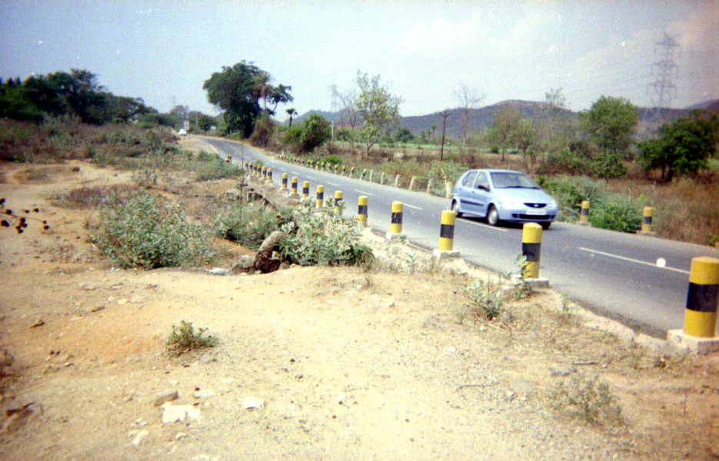
Upgradation of Rural Roads Bihar
Client Name:
RWD, Bihar
Length of road:
113 Km
Services Provided:
Topographical Survey, Hydrological Survey, Road Inventory, Bridge Inventory
Geotechnical Investigations
Traffic Counts, and Estimation of Future Travel Demand
Preparation of Detailed Project Report
Estimation of Project Cost
Preparation of Bid Documents
Key Features:
Strengthening and alignment correction of 113 Km. of Rural Road
Transwat Techno-Engineering Services Ltd

Slide 34
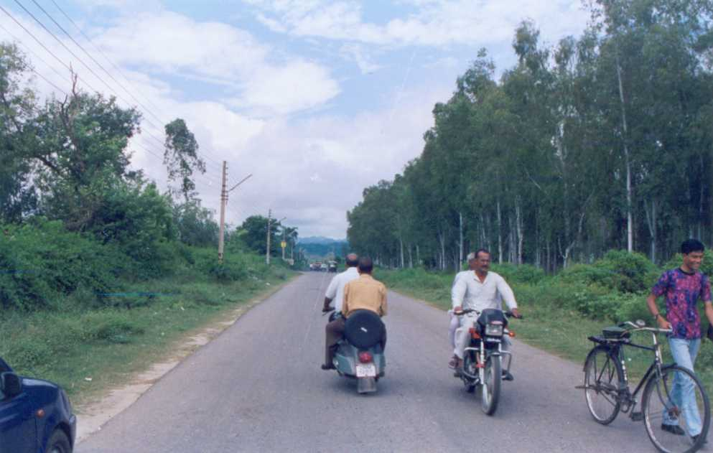
vg
Client Name:
RWD, Bihar
Length of road:
142 Km
Services Provided:
Topographical Survey, Hydrological Survey, Road Inventory, Bridge Inventory
Geotechnical Investigations
Traffic Counts, Axle Load Surveys and Estimation of Future Travel Demand
Preparation of Detailed Project Report
Estimation of Project Cost
Preparation of Bid Documents
Key Features:
Strengthening and alignment correction of 142 Km. of Road
1 No. of Bridge over River
Culverts of various sizes
Transwat Techno-Engineering Services Ltd

Slide 35
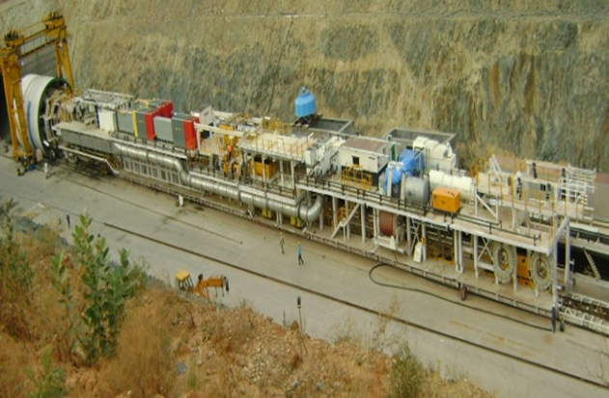
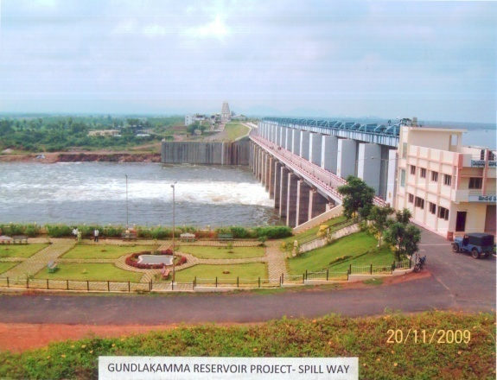

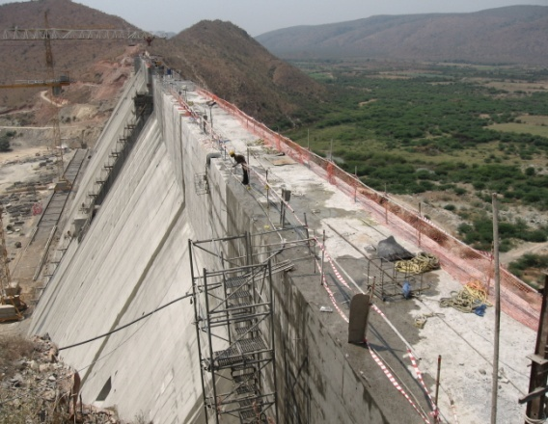
For Govt. of Andhra Pradesh | Third Party Quality Control Consultancy Services for Irrigation Projects in Andhra Pradesh
Irrigation & CAD Department
Govt. of Andhra Pradesh has taken up a massive construction programme in 2004-05, called “JALAYAGNAM”, of Major Irrigation Projects all over the State.
Large Scale Projects require multi-level construction supervision and quality control procedures; Third Party Quality Control Consultancy (TPQC) system has been adopted This programme envisaged deployment of huge resources at short notice, particularly Technical Experts, Engineers, Central Labs at project HQs / Field Labs / Mobile Labs at work sites so as to monitor quality aspect;
Third Party Quality Control Consultancy Assignments have been awarded for various Project components including Canals, Reservoirs (10 Nos), Dams (4 Nos), Tunnels (3 Nos, of which two with TBM), Lift Irrigation Scheme and other related structures.
A total of 69 nos. of EPC Contract Packages valued at about Rs. 10,000 Crores have been covered under ten different Consultancy Agreements, awarded from time to time
Latest Site Pic 2
Latest Site Pic 3
Transwat Techno-Engineering Services Ltd

Slide 36
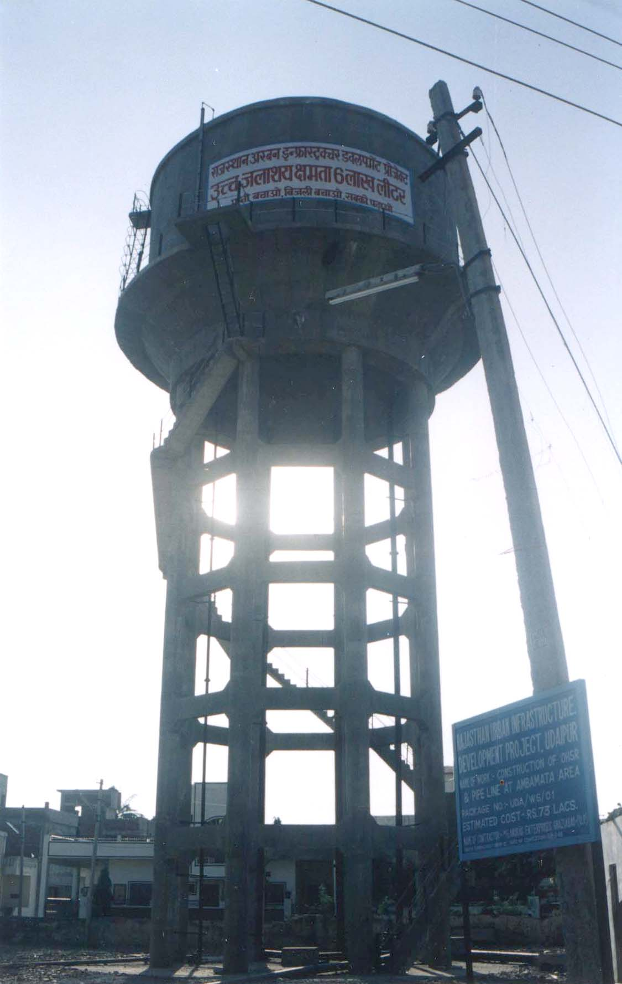
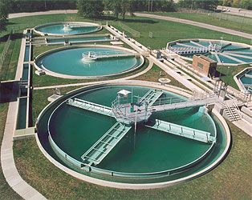
Consultancy Services – Urban Engineering & Development RUIDP
Project Name: Rajasthan Urban Sector Development Investment Program RUSDIP : RUIDP Phase II (ADB Loan No. 2366-IND)
Location: Bharatpur, Rajasthan
Project Brief :
Project is for integrated Urban Development including Design and Supervision Consultancy for improvement of Water Supply Rehabilitation & Expansion, Urban Environment, Urban Transportation and Management, Heritage and Tourism, Community Awareness and Participation, Capacity Development and Investment Program Management
Services Provided
Design & Construction Supervision Consultancy (DSC) Services
Transwat Techno-Engineering Services Ltd

Slide 37
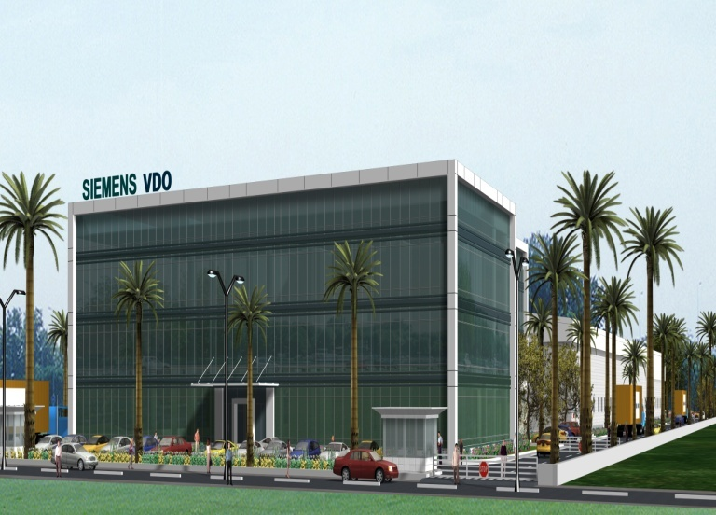
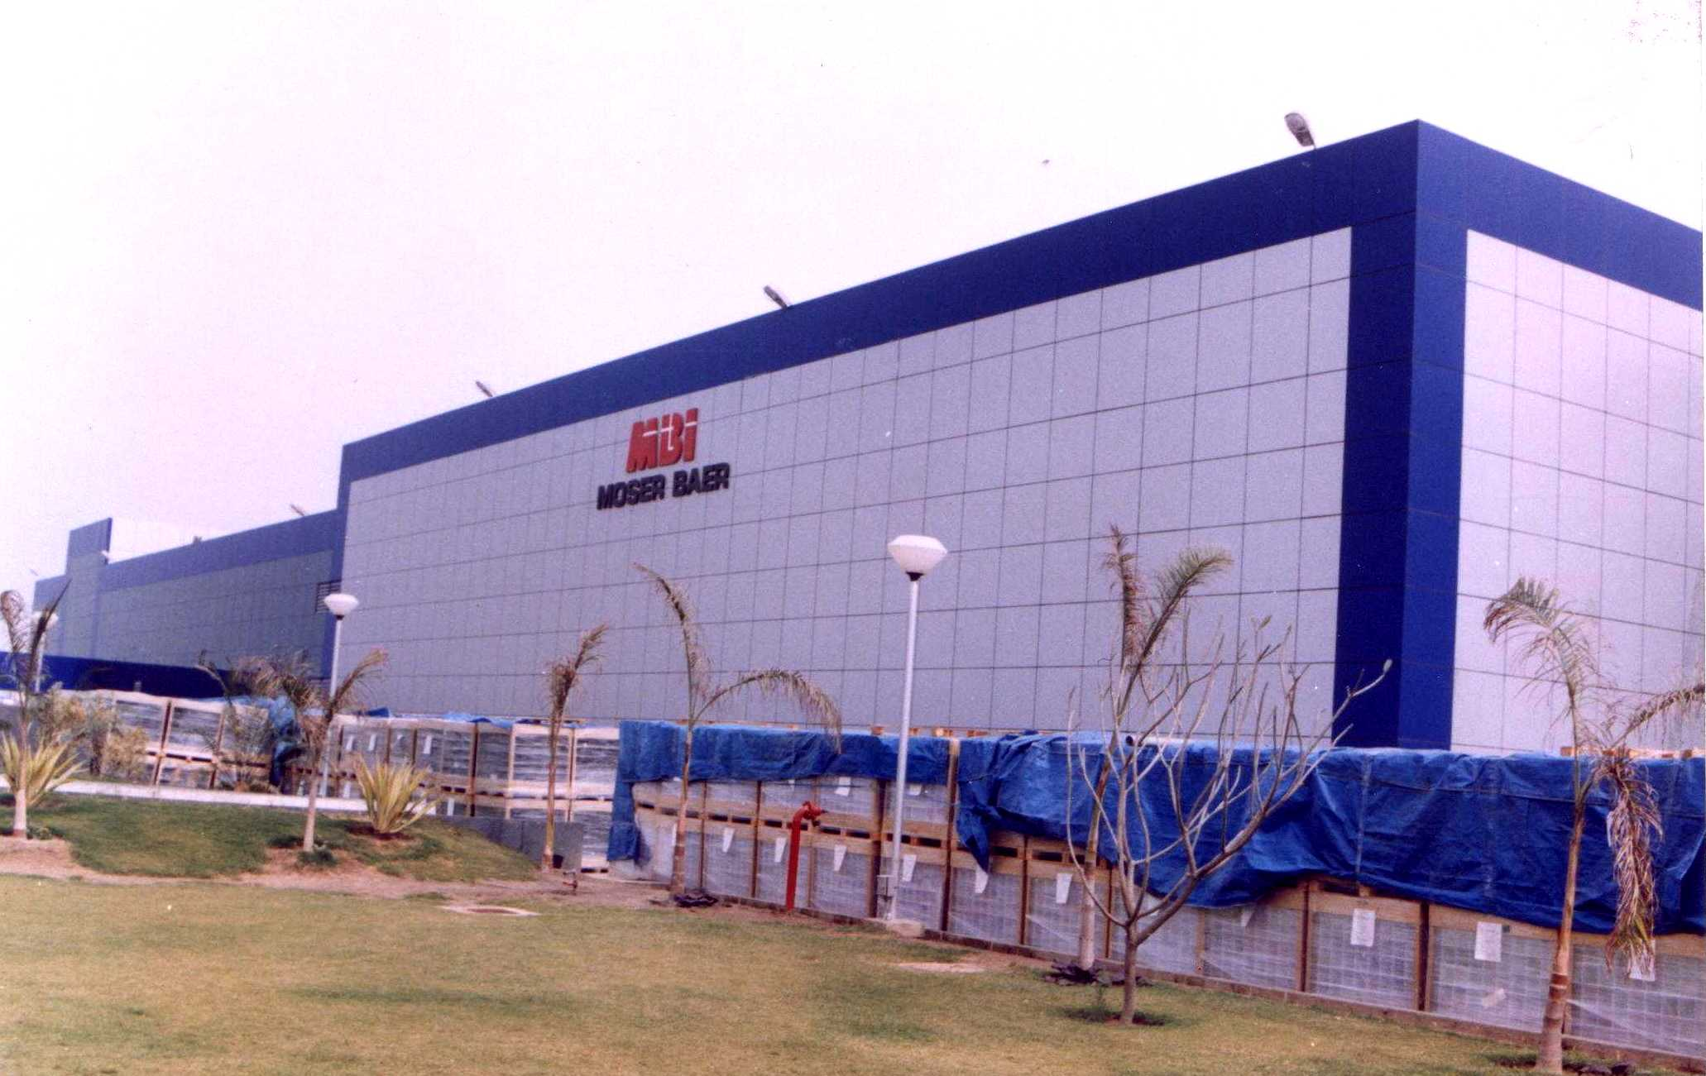
Consultancy Services – Industrial Projects
Project Name : Electronic Manufacturing and R & D facility
Client Name : Siemens Ltd. | Location: Bangalore, Karnataka
Project Brief : Electronic equipment manufacturing project comprising industrial, office and R&D facilities for SV Division, Automotive Products
Built Up Area : 14,150 M2 | Project Cost: 112 Cr
Status : Ongoing
Services Provided Design and Detailed Engineering Consultancy for Architectural , Structural Utilities and Supporting Infrastructure | Site Area Development Project Management Consultancy and Construction consultancy including day to day supervision
Project Name : Moserbaer CD-R Manufacturing Plant
Client Name : Moserbaer (I) Ltd.. | Location: Noida, U.P.
Project Brief : Area of Plot : 112 acres External development, boundary wall, bituminous & concrete roads, water supply, sanitary, sewerage, surface drainage systems , overhead & underground water tanks
Built Up Area : 1,60,000M² | Project Cost: INR 100.00 Cr.
Services Provided Master Planning of the Complex Project Management & Construction Management Design Engineering Consultancy for Architectural and Structural , Utilities and Supporting Infrastructure , Site Area Development
Transwat Techno-Engineering Services Ltd

Slide 38
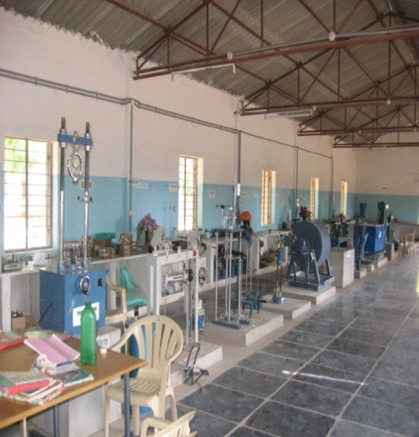
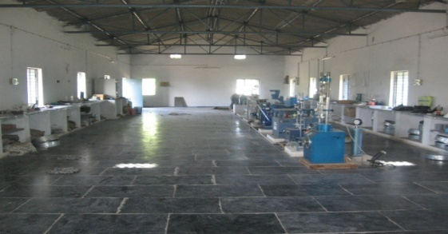
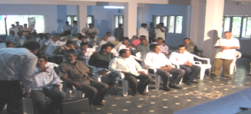
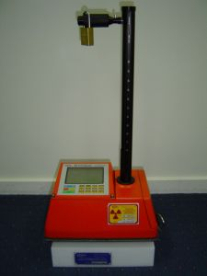
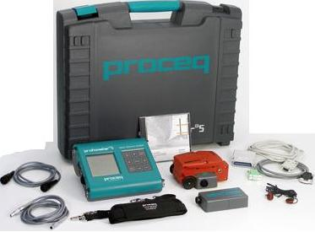
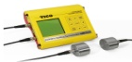
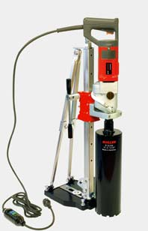
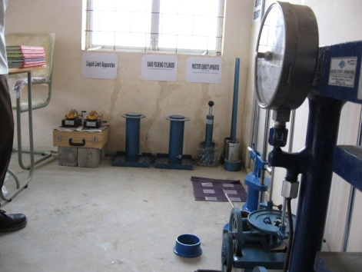
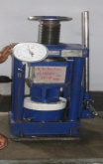


In-house Lab Facilities & Training Sessions / Technical Orientation
for performing Quality Control and Quality Assurance Services
38
Transwat Techno-Engineering Services Ltd
Notes:
38

Slide 39


































Key Clients
Key Clients
Transwat Techno-Engineering Services Ltd

Slide 40

CONTACT
Mumbai (HO)
Regd. Off : A-201, Upsahra Lane, Shree Arham Bluz, C.D. Barfiwala Cross Lane, Andheri (W), Mumbai – 400 058
Tel: 022 – 4454 5653
+91 - 98858 09317
Hyderabad
#8-2-686/K/1&2, C3, 2ndFloor,Kimtee Square,
Road No.12, Banjara Hills,
Hyderabad – 500 034
Telephone : +91-40-2332 0233; Mob : +91 - 9885474414
Delhi,
House no. 226 , Block No 3, Subhash Nagar, ]
New Delhi 110027
Mobile : +91 – 91121 48400 / +91- 9000347257,
For Enquiries, Please contact,
M Sridhar Reddy : 98858 09317 /
H Charles Sunny : 9000 347 257 / M Srinivasa Reddy : 95050 61118 /
Ms P Madhavi : 98854 74414 / Mr M Swaroop : 89781 09585
Email: bd@transwat.com
Website: www.transwat.com
Wadia Techno-Engineering Services Ltd
Transwat Techno-Engineering Services Ltd

